Slide 1
Mid-term presentation
Brave Ones : WeChat Mini-Program
Jilin University
Universidade de Trás-os-Montes e Alto Douro
2023/24

Slide 2
Team & Roles
Brave Ones
https://github.com/Divpeter/DSD2024.github.io
Nuno Valente | 🇵🇹 | Team Leader
Ang Gao (Peter) | 🇨🇳 | Sub-PM, Coder
Minye Lei (Kerry) | 🇨🇳 | Req. Analyst, Tester
Han Chen (Bright) | 🇨🇳 | Coder
Jerry Zheng | 🇨🇳 | Req. Analyst, Tester
Jerry Gao | 🇨🇳 | System Architect, Liaison

Slide 3
Objectives
WeChat Mini-Program
Requirements
System Architecture
Mini-Program development
Integration with backend
Testing

Slide 4
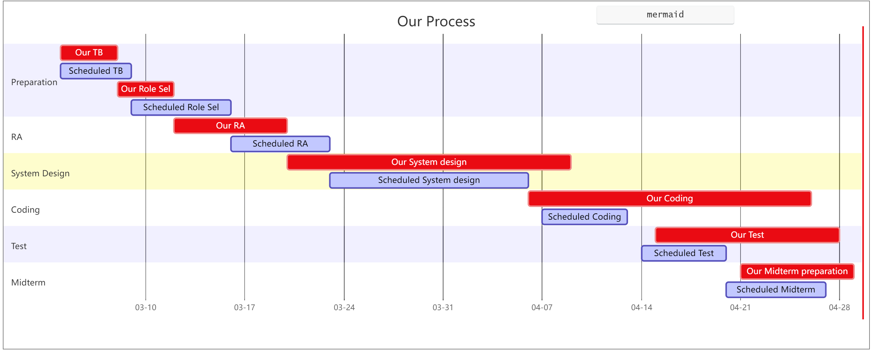
Progress
Fig. 1 - Gantt chart

Slide 5
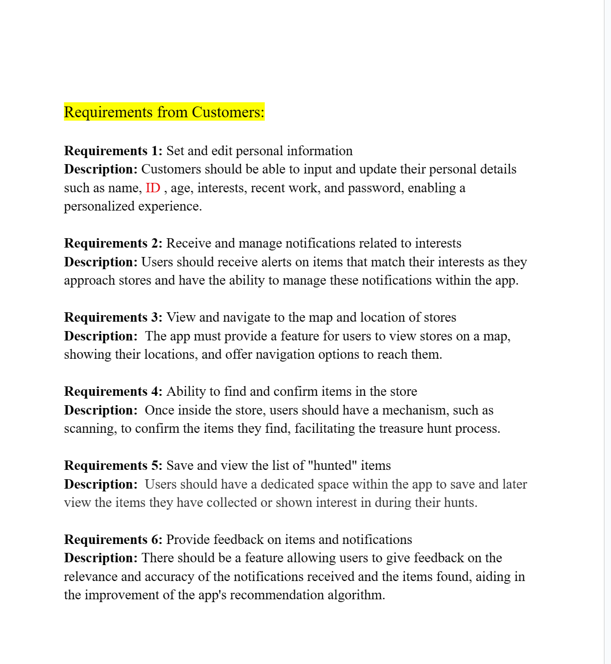
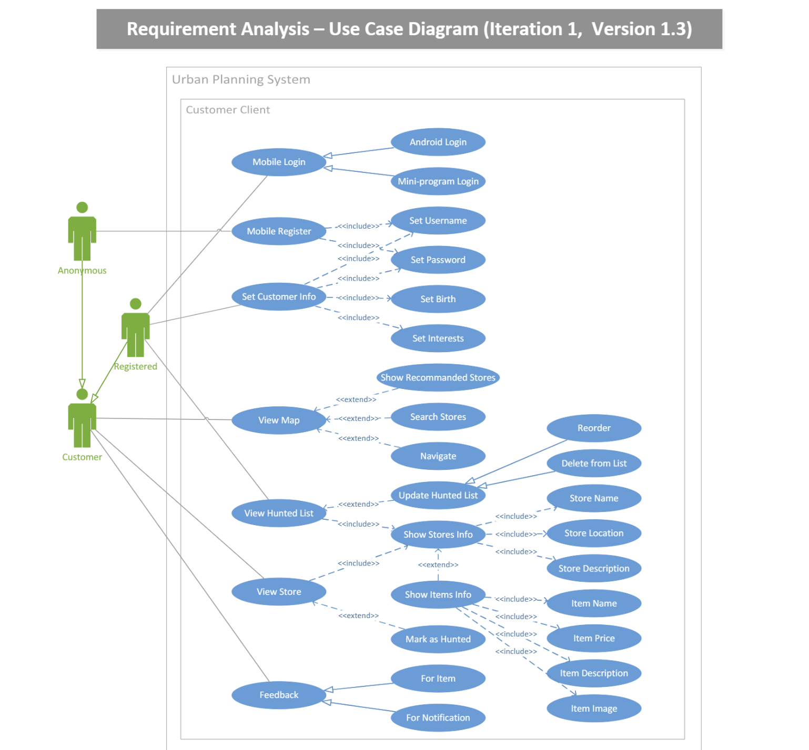
Part A: Requirements Analysis
Link: Requirements Analysis - Google Docs
Fig. 2.- Requirements list
Fig. 3 - Case diagram

Slide 6
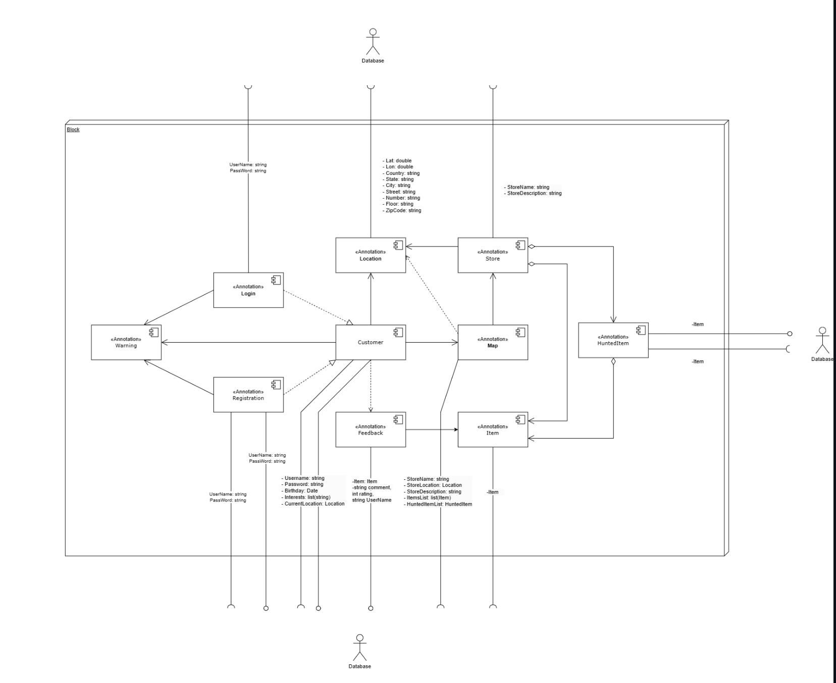
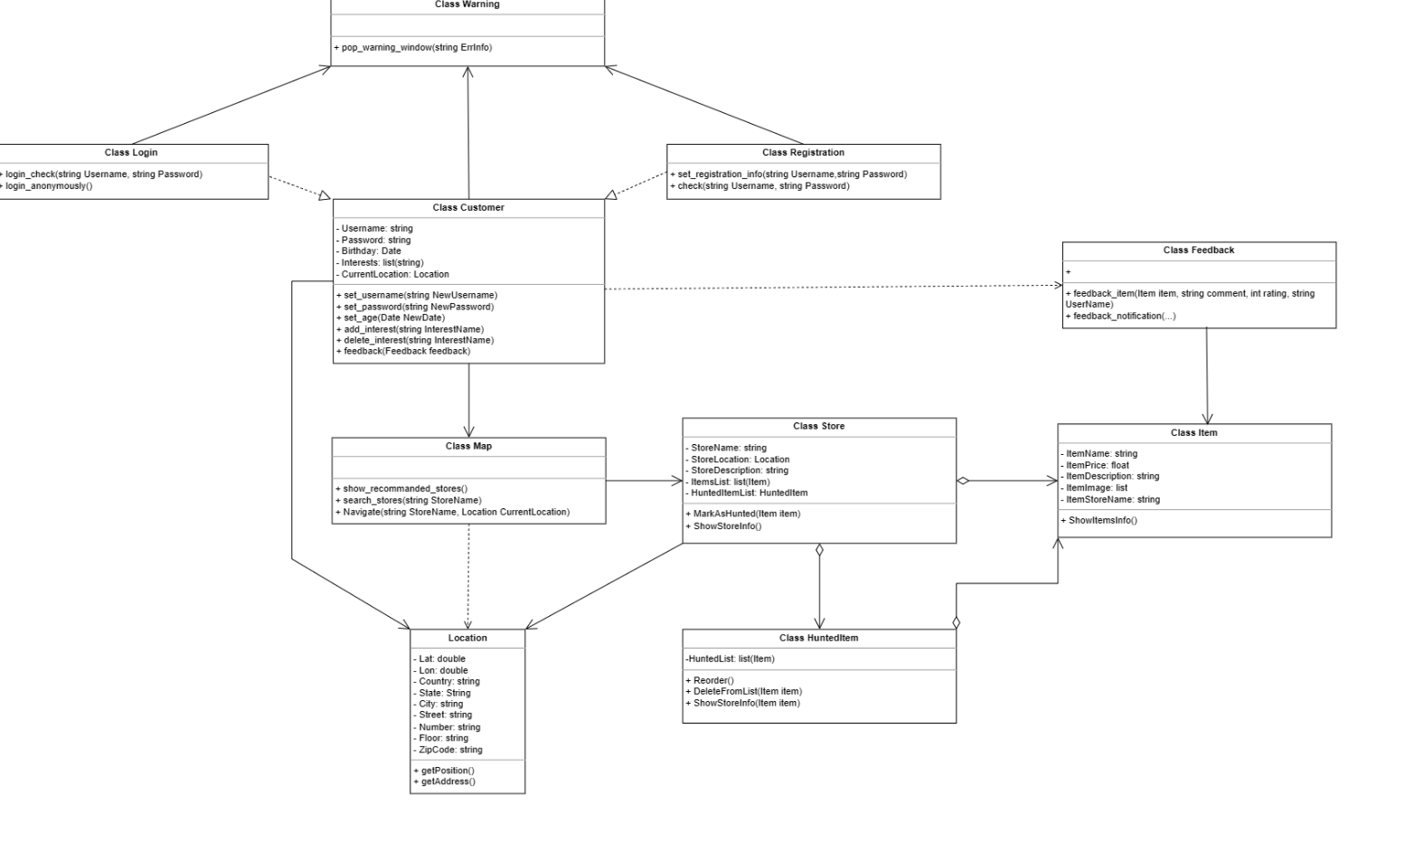
Part B: System Design
Fig. 4- Component diagram
Fig. 5 - Class diagram

Slide 7
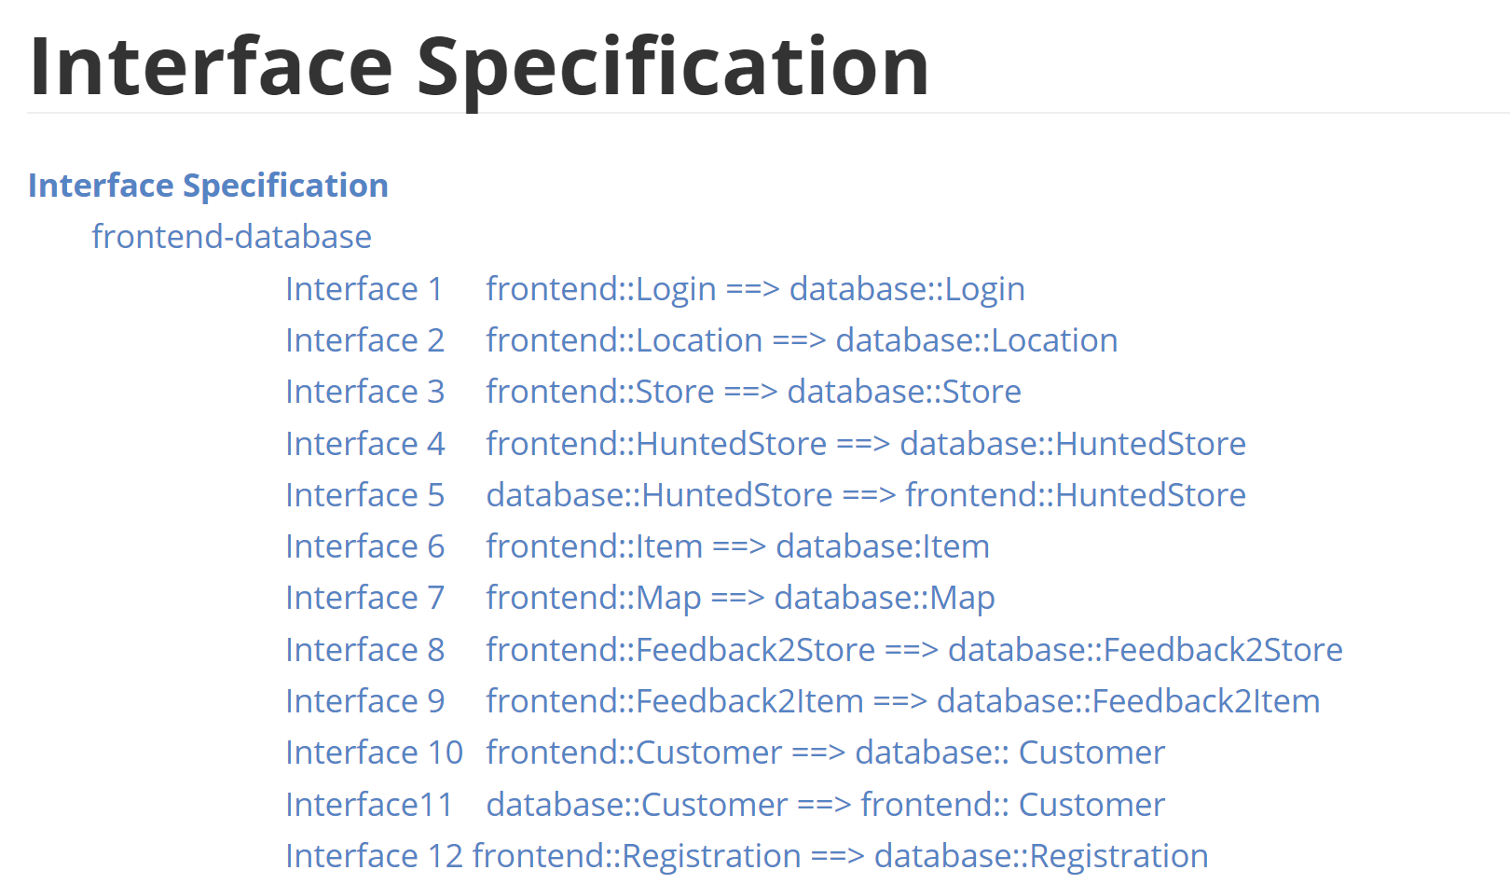
Interfaces document link: DSD2024-rock-house/Project Document/interface specification v.6.4.md at main · zhouyuheng2003/DSD2024-rock-house (github.com)

Slide 8
Part C: Program Development
Tool: WeChat Mini Program Official Development Platform
Link:微信公众平台 (qq.com)
Environment Statement:
Our group and Android group are using the same server to simulate the functionality of a database. All demonstrations below are based on the data stored in this server.

Slide 9
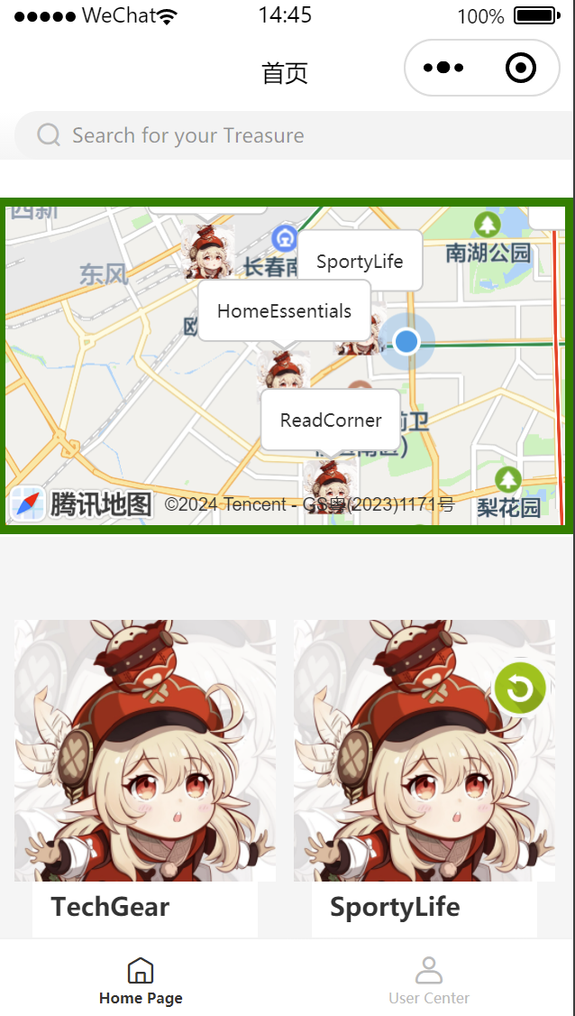
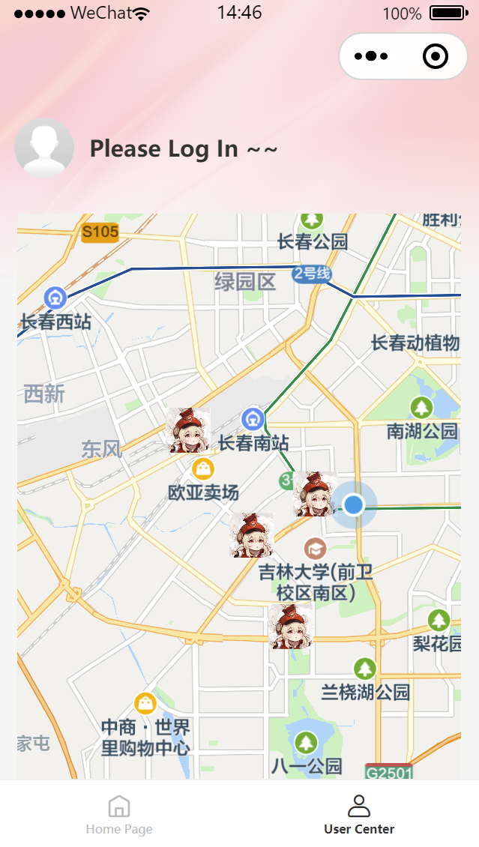
Page Overview:

Slide 10
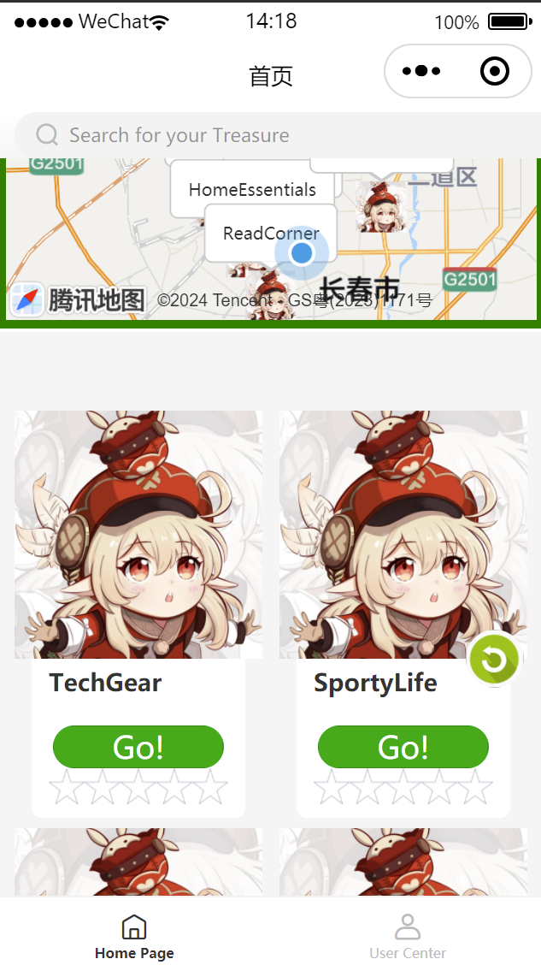
Function : View Recommended Storelist
Recommended Store
Store Name
Refresh
Navigation
Feedback Stars

Slide 11
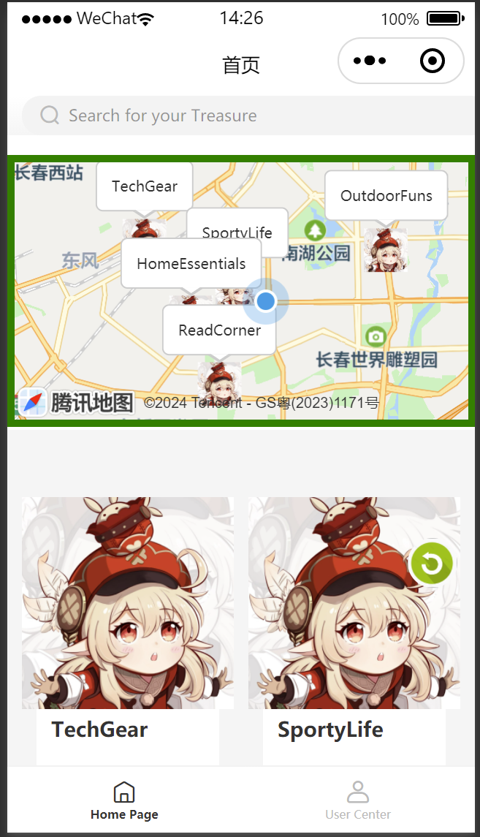
Function: Map
Recommended Store
Your Location

Slide 12
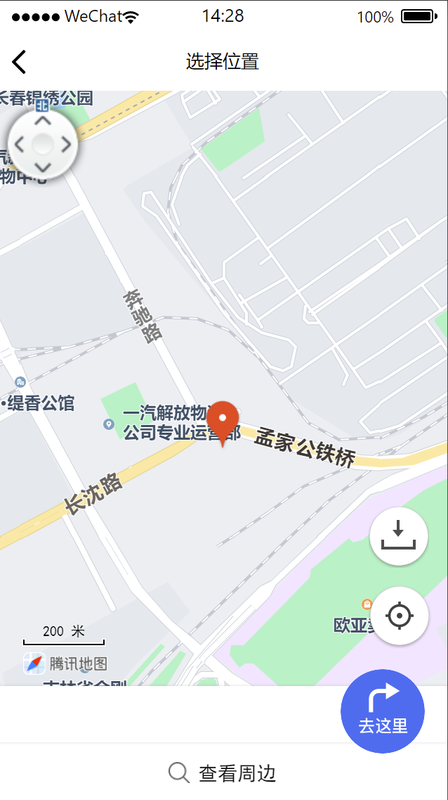
Function: Navigation
Click it
Go there

Slide 13
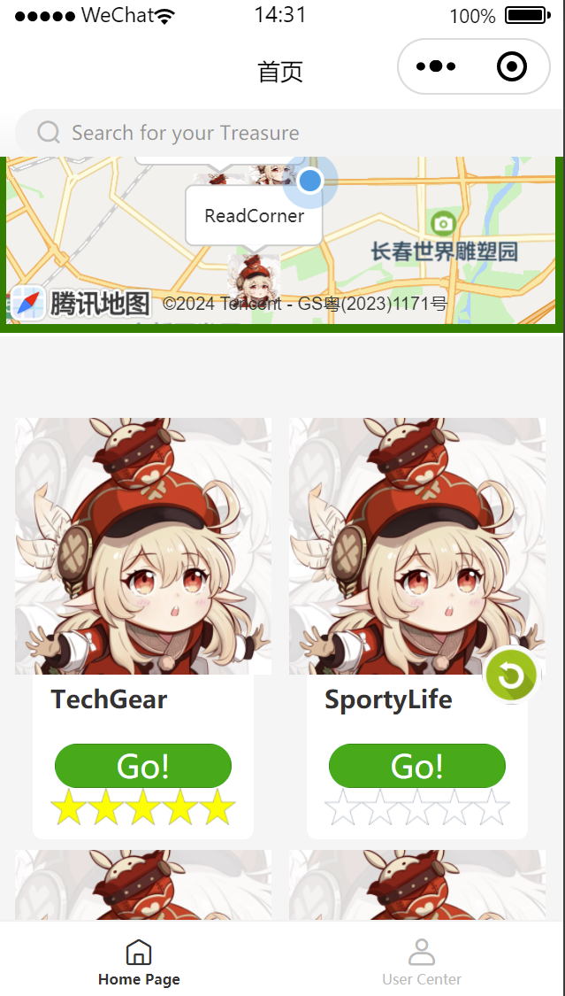
Function: Feedback
Click it

Slide 14
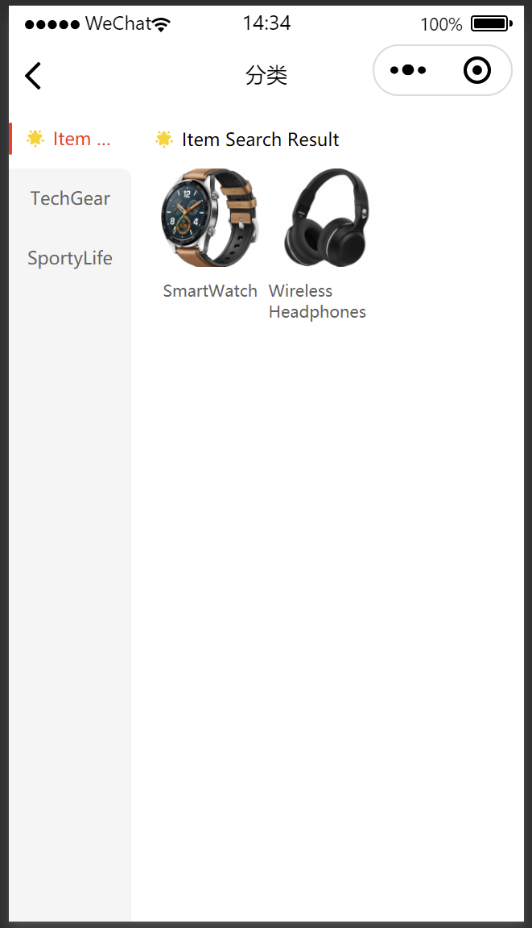
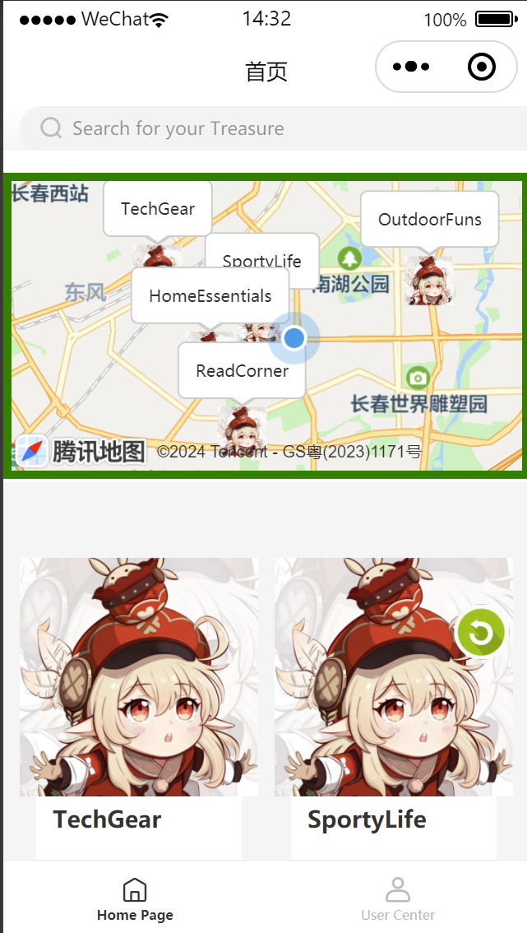
Function: Search
Search Bar
Search result

Slide 15
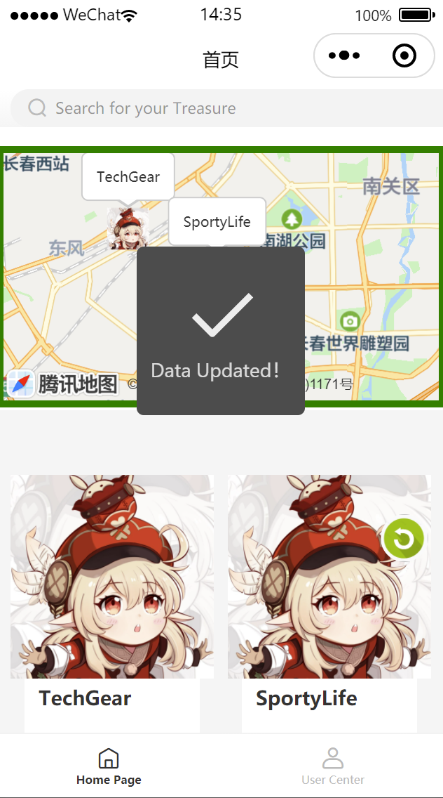
Function: Update
Two methods:
Click the green button
Set a interval to refresh it automatically

Slide 16
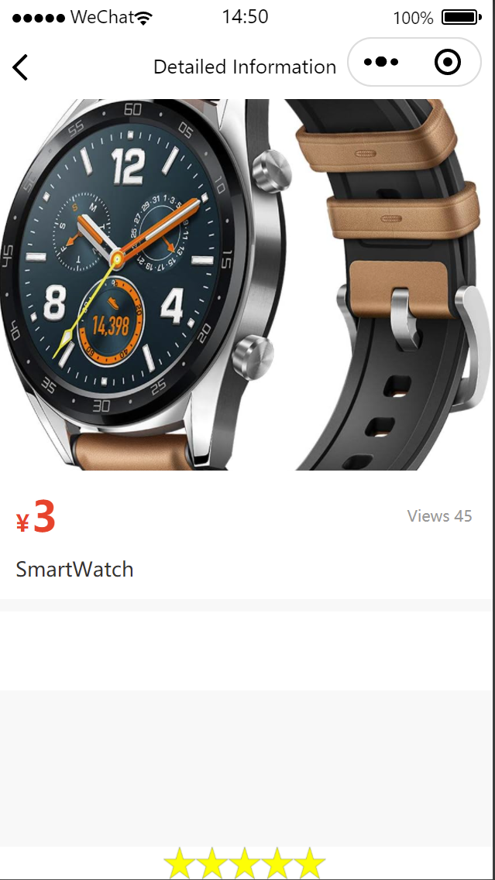
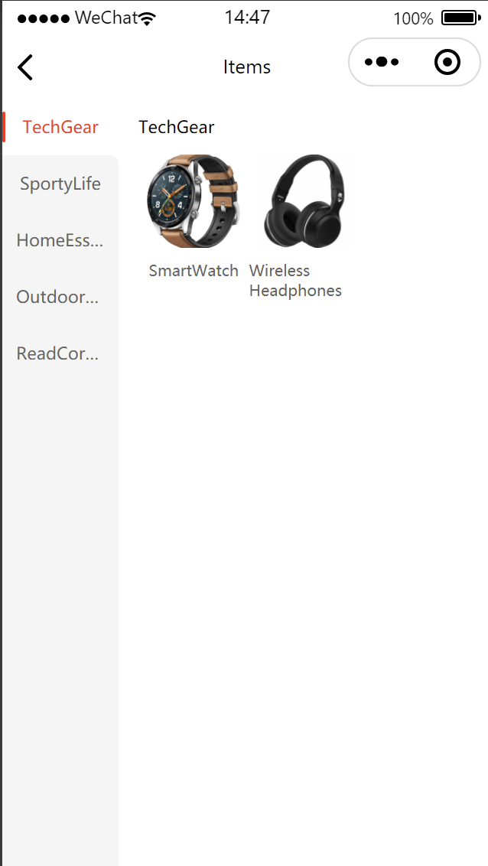
Function: view items and give feedback
Click the store
Click the item

Slide 17
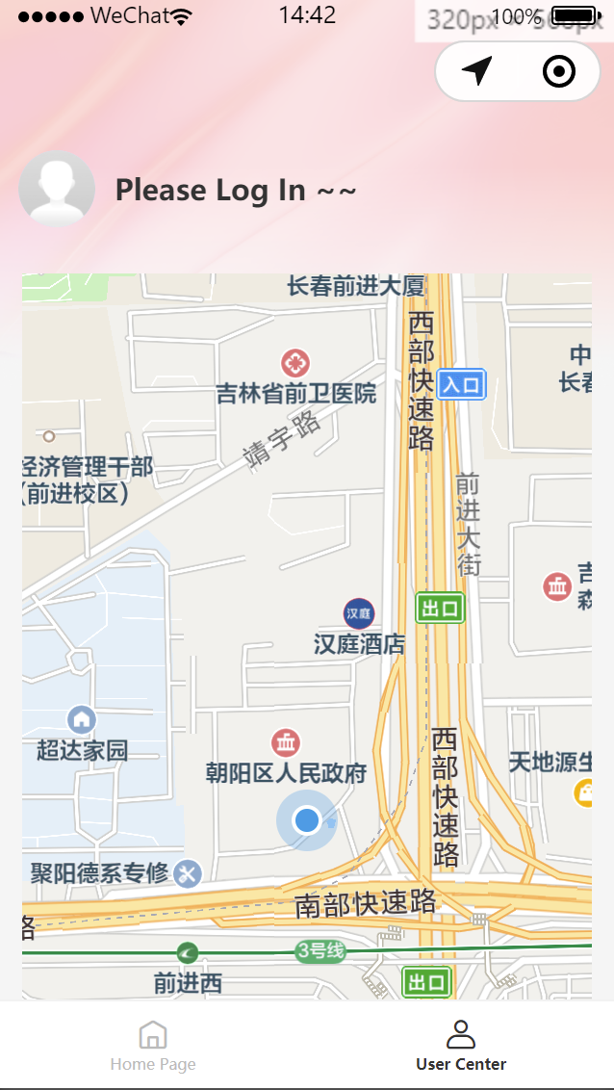
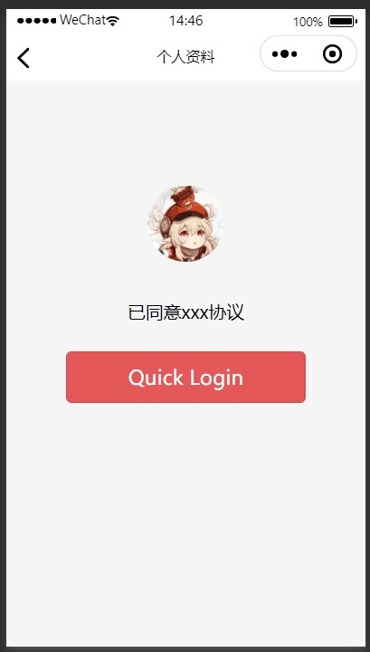
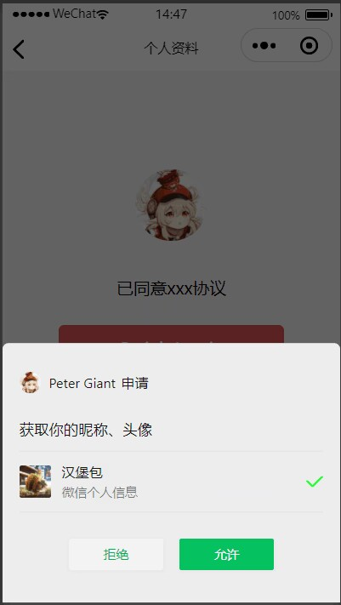
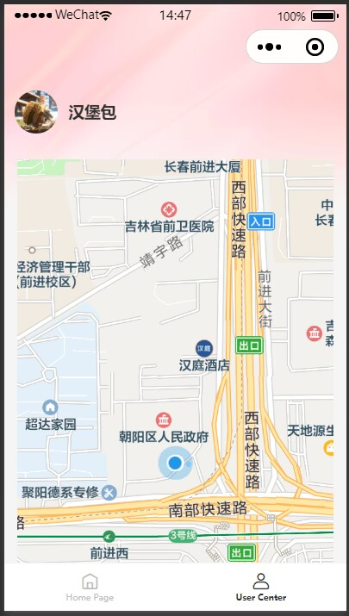
Function: Login

Slide 18
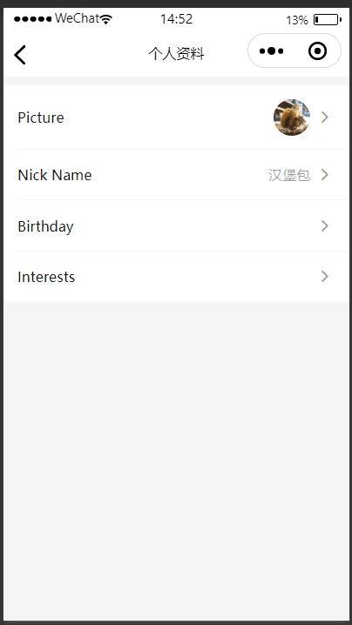
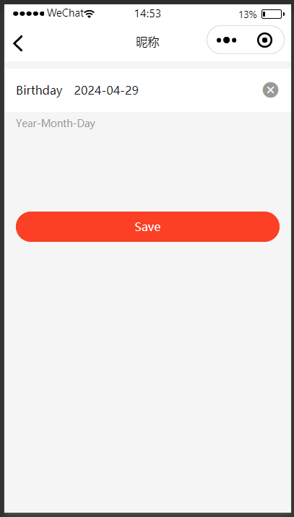
Function: User information edit

Slide 19

Demo

Slide 20
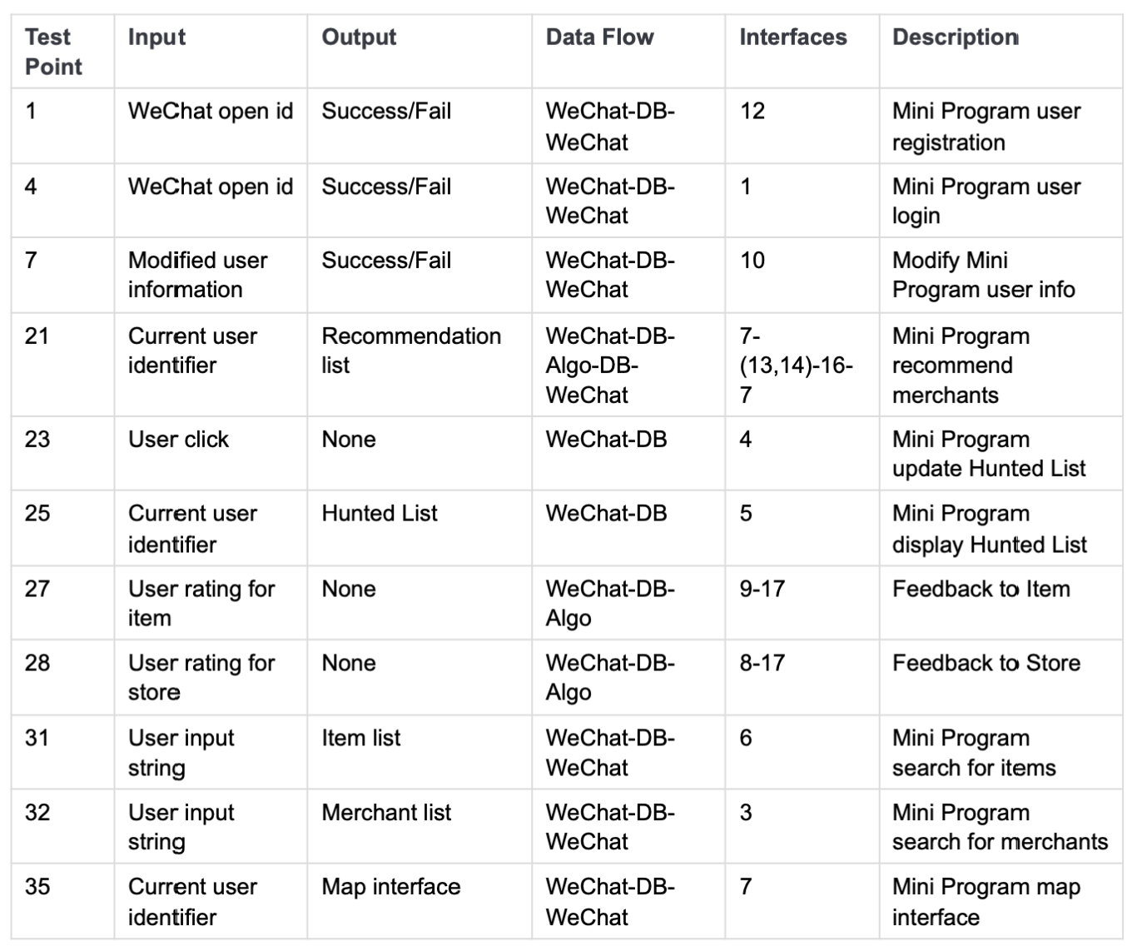
Tests

Slide 21
Future work
Implement interface 5 of interface specification
Unit and integration testing
Improve UI / UX

Slide 22
Thank you

